Slide 1
Data Access & Security
LEVEL - PRACTITIONER

Slide 2

Objectives
After completing this chapter, you will learn to:
  Define Salesforce.com Data Access Security
  Describe the 9 types of mechanisms for securing data access
  Create and Manage User Accounts

Slide 3

Overview ... 1
The salesforce.com platform includes an extensive set of security controls. These controls are documented in the salesforce.com User Guide which you can reference online from the application
These controls include:
  Object security
  Field level security
  Territory management
  Record Sharing
Every customer will implement security in a slightly different way
This module explains the most common ways to use salesforce.com security controls to configure the VEEVA CRM application

Slide 4
Overview ... 2
  The nine types of mechanisms for securing data access are:
    Profiles
    Permission Sets
    FLS
    Record Ownership
    OWD
    Role Hierarchy
    Territory Hierarchy
    Sharing rules
    Manual sharing

Slide 5

Do You Know
  Object security controls, which profile for a user (Specialty Sales or MSL for example) can create, read, update or delete (CRUD) records for a certain type object
  Field level security controls which profile a user (Specialty Sales or MSL for example) see and which fields users can edit on objects
  Data sharing rules can be applied to increase visibility to records that are Private or Public Read-Only and controlled by the Role Hierarchy AND Territory Management.
  Configuration for supporting Permission Sets requires the VEEVAUserPermissions Apex class to be installed, configured for Salesforce API v25+, and enabled for all profiles
  VEEVA CRM does not prevent the use of third-party keyboards.
  Third-party keyboards have the potential to capture, leak
  and misuse the keystroke data they process

Slide 6
Data Access & Security
Profiles

Slide 7
Profiles- Definition
A Profile is:
A collection of settings and permissions that determine:
  What users can see in VEEVA UI
  What can users do with what they see
Profiles must be defined based on job functions- such as System Administrators, Sales Reps, MSL and Managed Markets
Profile: User::1: M → One profile can be assigned to many users, but a user can be assigned to only one profile at a time
Post requirement-gathering, VEEVA Admins must set up user profiles at the very beginning
As best practice, keep the number of profiles to the minimum to minimize administrative overhead

Slide 8
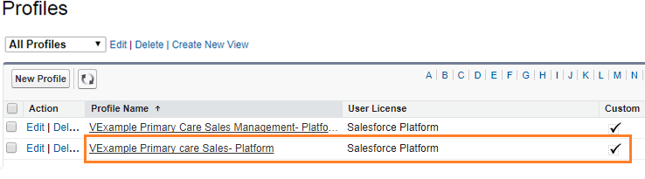
Profiles- Create
To create or manage Profiles:
  Navigate to Setup > Manage Users > Profiles
Default Profiles used by VEEVA for Salesforce Platform license have the word “Platform” in their names

Slide 9
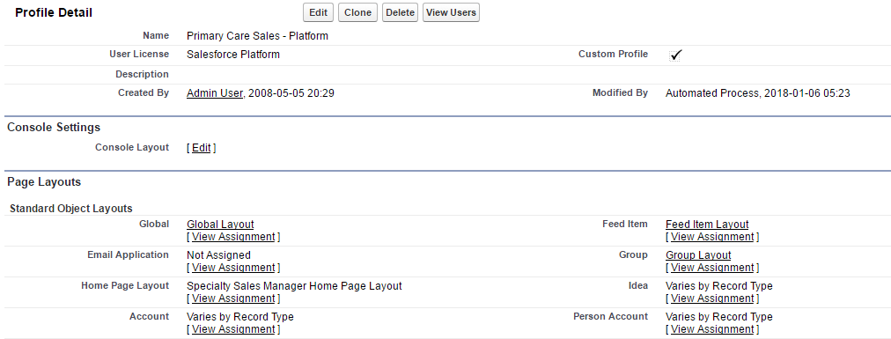
Profiles- Application Access
Application Access
An application is a collection of Tabs. This is defined at profile level
Typically, End-Users and Managers will have access to the VEEVA CRM application only
VEEVA Admins may have custom Applications such as Samples Management, Territory management & Data Stewardship that provide a specialized arrangement of Tabs

Slide 10
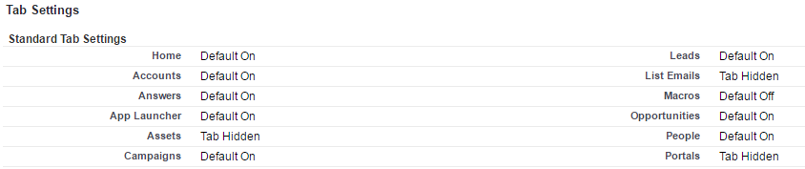
Profiles- Tab Access
Tab Access
Tabs control the top level objects that users can access
  Default On – tab will always appear on the tab bar
  Default Off – tab is available from the button
  Tab Hidden – tab is not available to the user; not be able to search on objects whose tab is hidden
Default off Tab
+
Default on Tab
Default off Tab

Slide 11
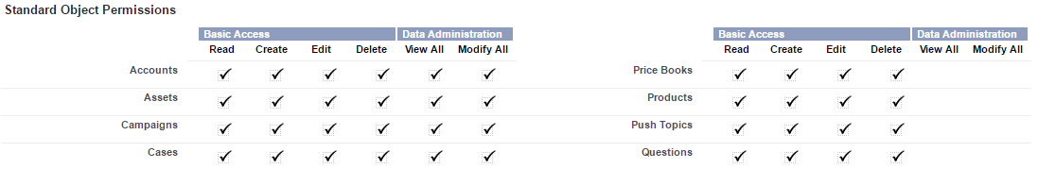
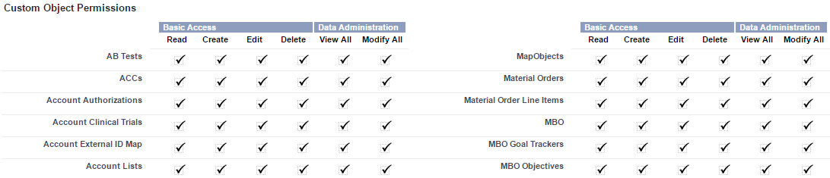
Profiles- CRUD for Object Access
CRUD Access
Controls whether users of a profile can read, create, edit, and delete records for each standard or custom object
System Administrators also have the “View All” and “Modify All” permissions on all objects
What objects can an user see?

Slide 12
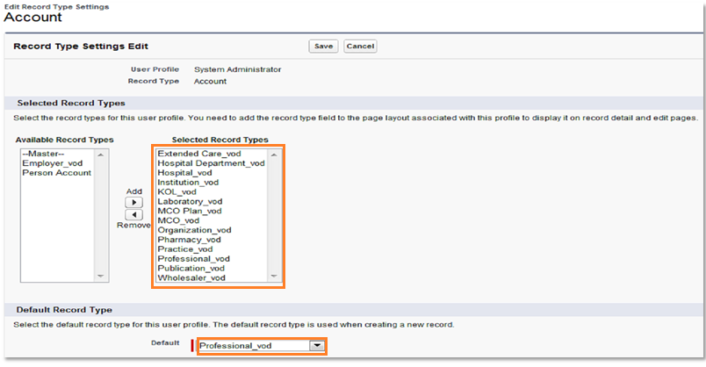
Profiles- Object record Type Access
Object record Type Access
Record Type Settings control which record types are available for each object for users of a profile
Record types will be covered in detail later in the module

Slide 13
Profiles- Field Level Security
What is Field Level Security?
Fields can be hidden or displayed to users in:
  Detail and edit pages, related lists, list views, reports
  Example: Hide the Territory field on the Accounts page from the users but display it for the Admin
Note: FLS does not prevent searching on the values within a field if you have visibility to the object
To set FLS on all objects and all fields for a single profile:
  Setup > Manage Users > Profiles > [Profile] > Field-Level Security > [Field]
To set FLS on a single field for all profiles:
  Setup > Create > Objects > [Object] > [Field detail page] > Set Field-Level Security button
What fields on those objects can an user see?

Slide 14
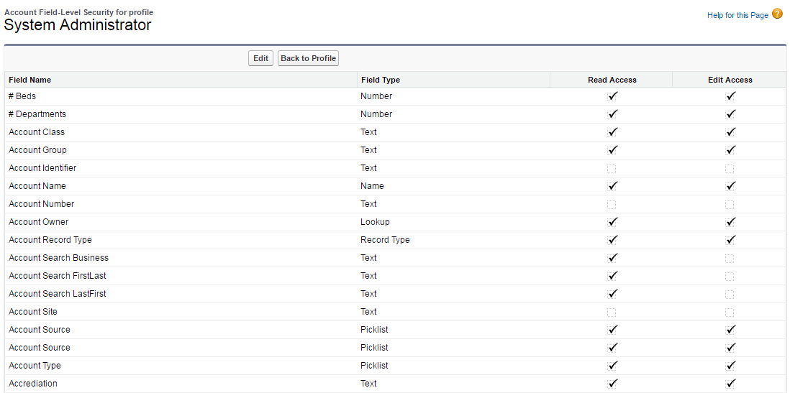
Profiles- FLS Access

Slide 15
Profiles- Additional Access
Profiles are also used to configure:
Page Layout Assignments
  Which page layout(s) is being used for all objects per profile
Enable Apex Class Access
  Which Apex Classes users of this profile have access to execute
Enable Visual Force Page Access
  Which Visual Force Pages users of this profile have access to in the application

Slide 16
Data Access & Security
Permission Sets

Slide 17
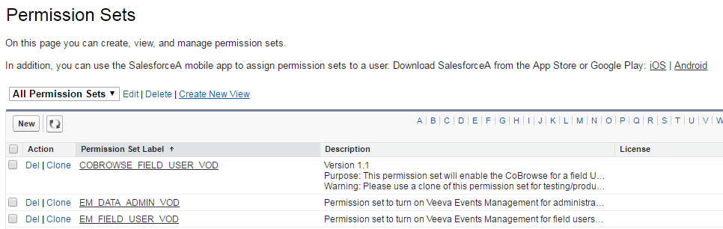
Permission Sets- Overview
Permission Sets feature:
Grants permissions at the user level without having to modify or clone Profiles
Define Profiles with minimum permissions and then give additional permission to specific users
Helps to reduce number of Profiles needed for the Org. For e.g., bifurcation between CORE and NON-CORE features
  Set Permission Set Support VEEVA setting to TRUE

Slide 18
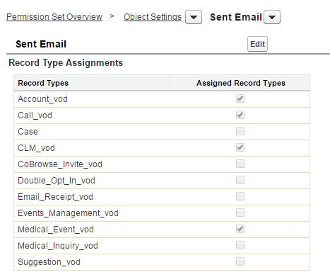
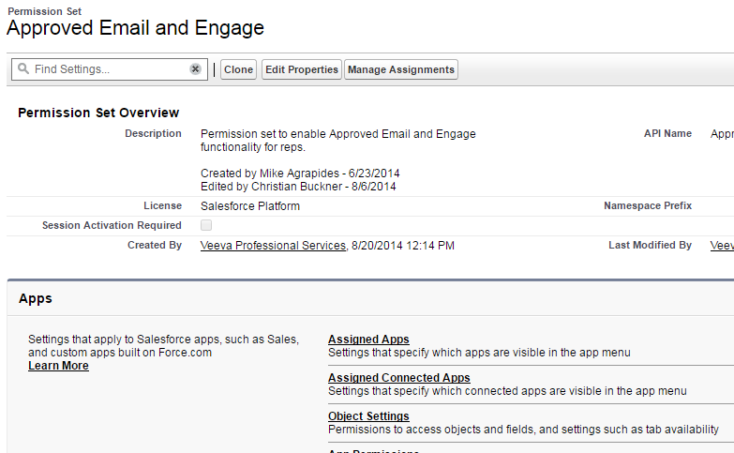
Permission Sets- Define
Define Permission Sets:
To create Permission Sets:
  Setup > Administration Setup > Manage Users > Permission Sets
Create or Edit Permission Sets are needed- similar to defining a role
Select Section and then Edit Permissions

Slide 19
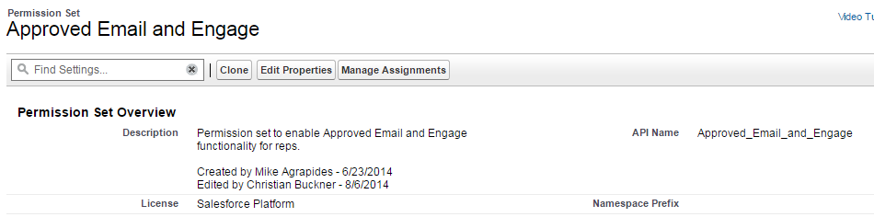
Permission Sets- Assignment
Assign Permission Sets:
Once defined, assign Permission Sets to uses
  Click the Manage Assignments button
  Assign a Permission Set to up to 1000 users at a time
  VEEVA Admins can also assign Permission Sets from the user records

Slide 20
Data Access & Security
Record Access

Slide 21
Record Access- Ownership
Record Ownership:
Ownership is a fundamental element driving the concept of “shared visibility” to control how data is shared
All records in the system must have an owner. By default, the owner of a record is the creator (which includes, System Integrator/Data Migrator user)
Owner Access gives permission to:
  View, Edit, Delete, Transfer & Share

Slide 22
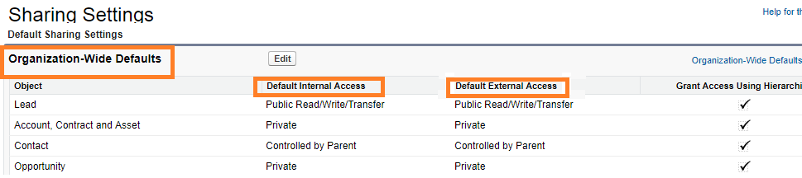
Record Access- OWD
Organization-Wide Defaults:
OWD controls data visibility to data records at each object
  Access OWD Settings from
  Setup > Security Controls > Sharing Settings
Which records should be hidden by default?

Slide 23
Record Access- OWD- Setting Types
OWD Settings:
Organization-Wide Default (OWD) has FOUR settings
  Private- Allows only the record owner to view and edit the record
  Public Read Only- Allows all users to view records of an object regardless of record ownership
  Public Read/Write- Allows all users to view and edit records of an object regardless of record ownership. For obvious reasons, this setting is used RARELY
  Controlled by Parent- Takes the OWD setting at the parent object. For example, Address takes Account’s OWD setting. Address is a VOD object that in detail relationship with Account (as Master)

Slide 24
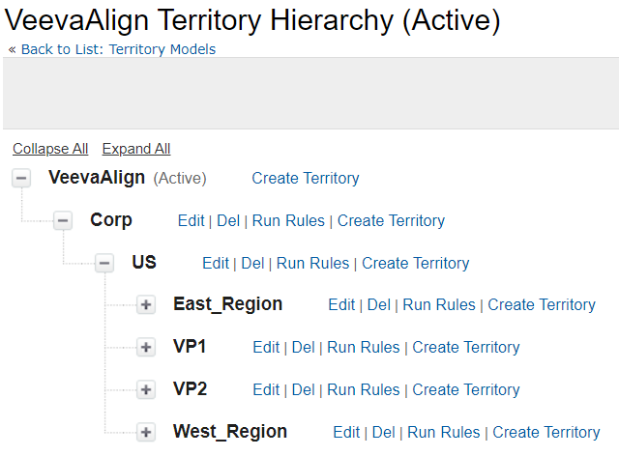
Record Access- Territory Hierarchy
Account Access through Territories:
This applies to VEEVA My Accounts only
Accounts can be aligned to one or more Territories
Users are assigned to a single Territory. However, Admins can temporarily assign them to more than one territories, if needed)
Visibility to accounts is shared up the territory hierarchy
  To access and setup, go to:
    Setup > Mange Territories > Role Hierarchy
  Add territories as well as edit, delete and assign users to territories

Slide 25
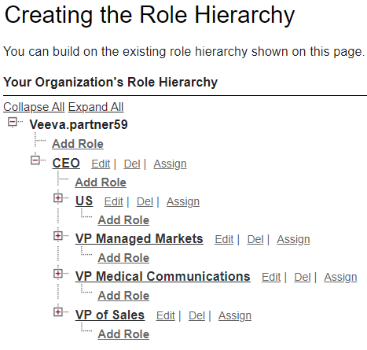
Record Access- Role Hierarchy
Role Hierarchy (Vertical Sharing):
The Role Hierarchy gives managers visibility to the data with private OWD (excluding Accounts) owned by their direct reports
  To access Role Hierarchy, go to:
    Setup > Manage Users > Roles > Setup Roles button
  Add roles as well as edit, delete and assign users to roles

Slide 26
Record Access- Sharing Rules
Private data can be shared when needed:
Private data can be shared to users and public groups
Allow greater access for designated users
Can never be stricter than OWD settings
This is also known as horizontal sharing
What exceptions should we make?

Slide 27
Record Access- Sharing Rules Access
Configuration:
Sharing rules are defined for one-way sharing
Two sharing rules are needed to share data between groups
VEEVA Admins can create Public Groups to include individual users and/or roles
To access sharing rule, go to:
  Setup >Security Controls > Sharing Settings > Sharing Rules
  (both owner based & criteria based)

Slide 28
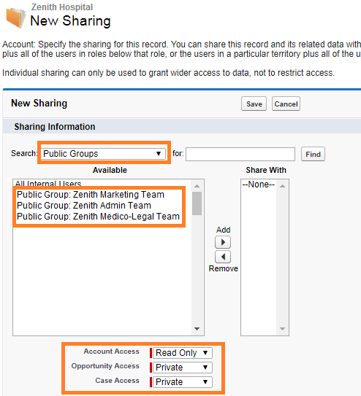
Record Access- Manual Sharing
What exceptions should we make?
Private data can be shared manually when needed:
VEEVA Admins may need to share records manually with Public Groups, individual users and/or roles
Can never be stricter than OWD settings
This is also known as manual horizontal sharing
To provide manual sharing, go to:
  Record detail page > click on ‘Share’ button > click ‘Add’ button on Sharing Detail page

Slide 29
Record Access- Account Owner
The VEEVA My Accounts tab displays an Account if:
  The Account belongs to the user’s territory
  OR
  The user “owns” the Account
VEEVA implementations in which users are allowed to create Accounts
  Create a workflow that updates the Account Owner field and sets it to a designated Admin user
If the Accounts are realigned to different territories:
  Users still see Accounts they own even though the account is no longer in the user’s territory

Slide 30
Data Access & Security
User Management

Slide 31
User Management
In Salesforce, every user is identified by a username, password, a single profile and a single role, and one or more territories which determines:
  What tasks users can perform
  What data they see
  What they can do with the data
VEEVA Admins can also perform the following user management functions:
  Creating or inactivating users
  Resetting passwords
  Unlocking users
  Logging in as another user (Enable Login Permission required)

Slide 32
User Creation
Things to keep in mind while creating a new user:
  Username (mail address) must be unique across Salesforce
  User records can’t be deleted. Inactivate the user if he/she no longer uses VEEVA
  User License must be set to Salesforce Platform for VEEVA licenses
  Assign a manager when enabling an Approval workflow

Slide 33
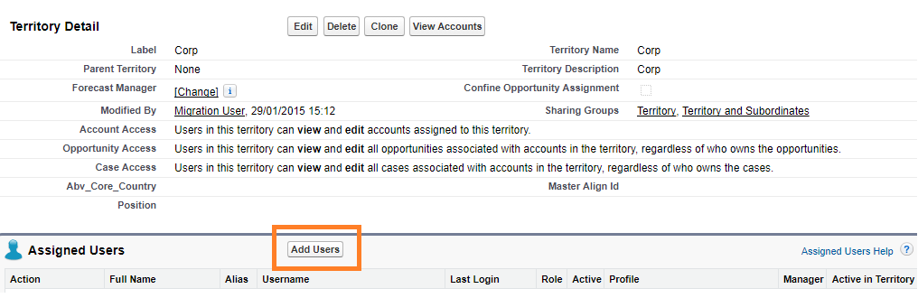
Add User to a Territory
Add User to a Territory:
  To access and setup territory hierarchy through the UI:
    Setup > Manage Territories > Hierarchy
  Click the Add Territory link to build the territory hierarchy
  Add user(s) to the territory’s Assigned Users

Slide 34
Best Practices – OWD vs Profile
VEEVA Admins must lock down data to the most restrictive level (in OWD), and then use profiles to selectively give users the ability to manipulate the data
  If all users need to read Medical Events but some users need to edit them, then set the OWD to Public Read and grant certain user profiles Edit permission to the Medical Event object
You can also use Permission Sets to avoid too many profiles

Slide 35
Best Practice - Territory Vs. Role
In VEEVA implementations the Territory and Role hierarchies should be identical
VEEVA Admins must focus on creating the Territory hierarchy and then make the Role hierarchy exactly the same
Territory hierarchy provides additional access to account, opportunity and case object. Role hierarchy provides access for ALL objects like coaching reports, others

Slide 36
Check Your Understanding ... 1
1. Which of these is not a mechanism for controlling record-level access?
Field Level Security
Sharing Rule
Org Wide Default
Role Hierarchy
Answer: Field Level Security

Slide 37
Check Your Understanding ... 1
2. User license must be of which type for VEEVA license?
Salesforce Platform
Salesforce
Partner
VEEVA Platform
Answer: Salesforce Platform

Slide 38
Check Your Understanding ... 1
3. User records cannot be deleted.
State True or False
True
False
Answer: True

Slide 39
Check Your Understanding ... 1
4. The _____ gives managers visibility to the data with private OWD (excluding Accounts) owned by their direct reports.
Role Hierarchy
Territory Hierarchy
Answer: Role Hierarchy

Slide 40
Check Your Understanding ... 1
5. Owner Access gives permission to:
View, Edit, Delete, Transfer & Share
Edit, Delete, Transfer & Share
View, Edit, Delete & Share
View, Edit, Delete & Transfer
Answer: View, Edit, Delete, Transfer & Share

Slide 41

Summary
In this module, you have learnt to :
  Define Salesforce.com Data Access Security
  Describe the different mechanisms for securing data access
  Discuss how to manage user accounts

